Slide 1
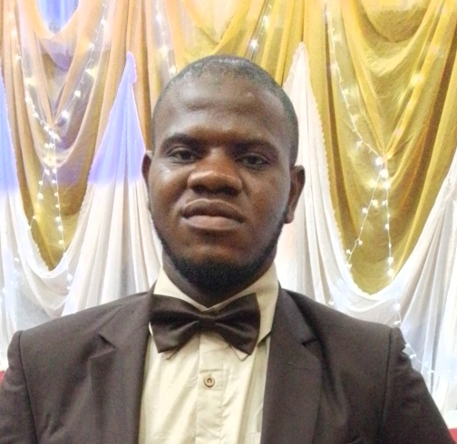
Seidu Suleiman
Data Analytics Intern at Oasis Infobyte

Slide 2
Customer Segmentation Analysis
Task 2
Unlocking Insights for Targeted Strategies

Slide 3
Objectives of the Analysis
Understand customer behaviors and spending patterns.
Identify distinct customer segments for tailored marketing strategies.
Improve customer retention and increase sales through targeted actions.

Slide 4
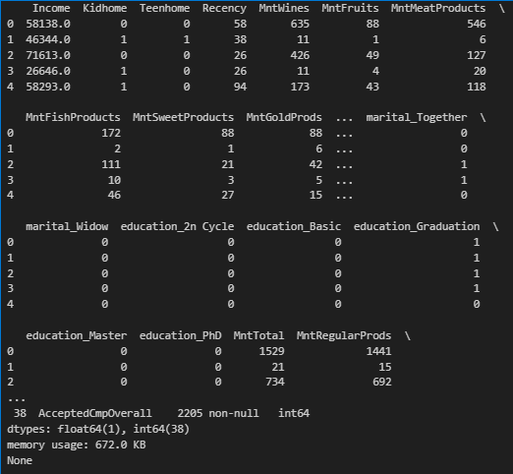
Dataset Overview
Total Records: 2,205 customers.
Features: Income, spending across categories, purchase channels, demographics, etc.
Key Metrics: Total spending (MntTotal), Recency, Age.

Slide 5
Approach and Methodology
Step 1: Data selection and cleaning.
Step 2: Standardization of features using StandardScaler.
Step 3: Determining optimal clusters using Elbow Method.
Step 4: Clustering with K-Means.
Step 5: Visualization using PCA.

Slide 6
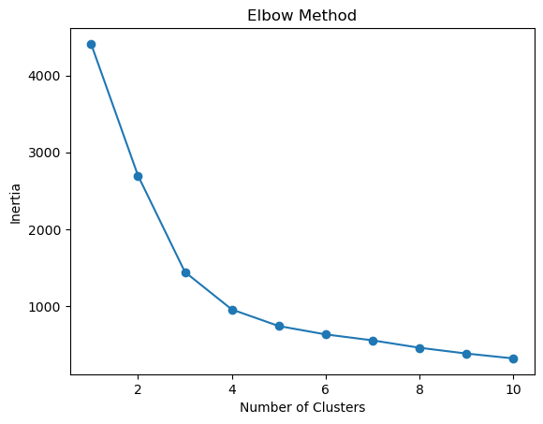
Finding Optimal Clusters
Explanation: The Elbow Method identifies the best number of clusters by observing where the inertia (sum of squared distances) starts to level off.
Optimal clusters: 4 clusters.
Elbow Method for Optimal Clusters

Slide 7
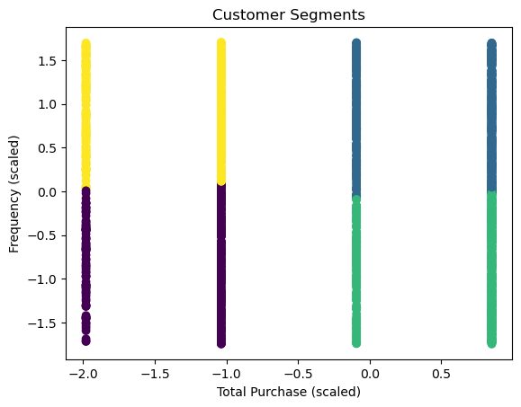
Customer Segments Visualization
Visualization of customer segments in 2D space using PCA.
Key takeaway: Distinct, well-separated clusters.

Slide 8
Customer Segment Profiles
Cluster # | Characteristics | Key Behaviors | Size
0 | High-income, high-spending | Purchases luxury items | 520
1 | Budget-conscious, promo-driven | Responds to discounts | 450
2 | Family-oriented, high spending on essentials | Focuses on value and kids | 680
3 | Inactive, low spending | Needs reactivation | 555
Table showing Customer Segment Characteristics

Slide 9
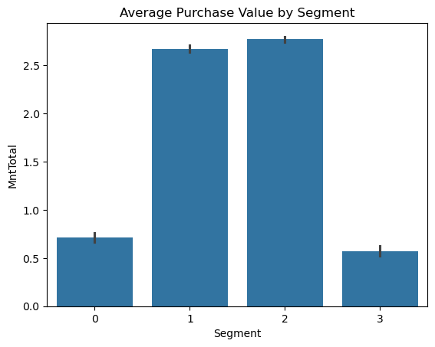
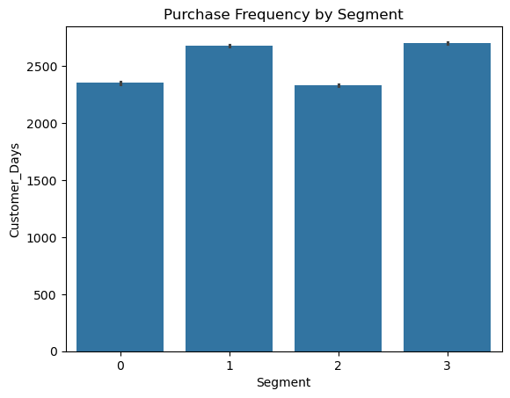
Customer Segment Profiles
Bar charts showing Customer Segment Characteristics

Slide 10
Recommendations
Tailored Strategies for Each Segment
Cluster 1 (High-Income Customers):
Offer premium products, loyalty rewards, and exclusive access.
Cluster 2 (Budget-Conscious):
Promote discounts and referral programs.
Cluster 3 (Family-Oriented):
Create family-friendly bundles and campaigns.
Cluster 4 (Inactive Customers):
Use "We Miss You" campaigns and targeted reactivation strategies.

Slide 11
Conclusion
Key Insights:
Customer segmentation reveals actionable strategies to improve engagement.
Distinct behaviors call for tailored marketing approaches.
Next Steps:
Implement recommendations.
Monitor results and adjust strategies as needed.

Slide 12
Thank
You!

Slide 13
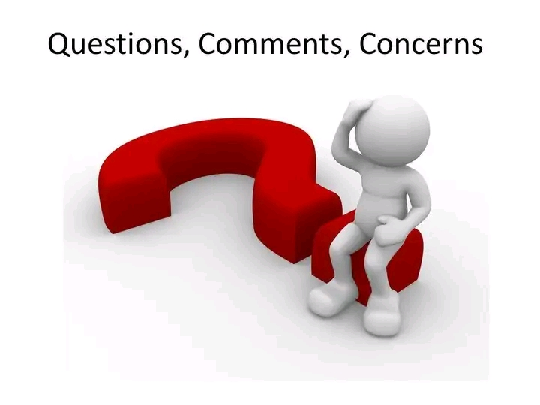
Let me know!
Email
seidusuleiman0@gmail.com
Linkedin
https://www.linkedin.com/in/suleiman-seidu-8b2135343

